Slide 1
Symbols and Irony in Literature

Slide 2
What is a Symbolism
Symbolism is the use of symbols to signify ideas and qualities by giving them symbolic meanings that are different from their literal sense.
Symbolism can take different forms

Slide 3
Functions of Symbolism
Symbolism gives a writer freedom to add double levels of meanings to his work: a literal one that is self-evident and the symbolic one whose meaning is far more profound than the literal one.
Symbolism in literature evokes interest in readers as they find an opportunity to get an insight of the writer’s mind on how he views the world and how he thinks of common objects and actions, having broader implications.

Slide 4
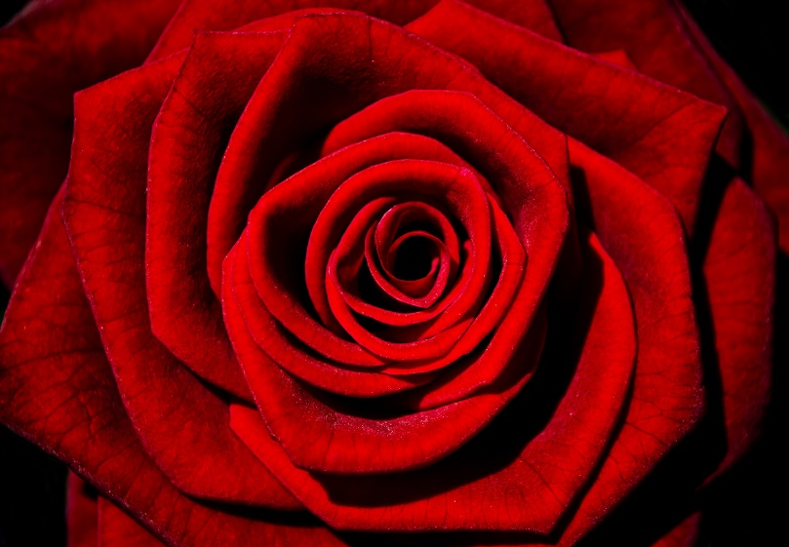
Common Symbols
A dove is a symbol of peace
The color red or a red rose is a symbol for love or romance
A sunrise is a symbol for a new start

Slide 5
What are these symbols of?
An eagle
A skull
Spring time

Slide 6
Irony
A contrast between the expectations for a situation and what is reality.
There are three types of irony:
Situational
Verbal
Dramatic

Slide 7
Situational Irony
An outcome that turns out to be very different from what was expected, the difference between what is expected to happened and what actually does.
Example:
The fire station burns down
A pilot that has a fear of flying
A police station gets robbed

Slide 8
Verbal irony
Verbal irony when a speaker speaks something contradictory to what he intends. A statement with an underlying meaning.
Also known as Sarcasm, Mockery
Examples:
Looking at her son’s messy room, Mom says, “Wow, you could win an award for cleanliness!”
On the way to school, the school bus gets a flat tire and the bus driver says, “Excellent! This day couldn’t start off any better!”

Slide 9
Dramatic Irony
Dramatic irony is when the reader or audience knows something that the character does not.
Examples:
In a scary movie, the character walks into a house and the audience knows the killer is in the house
In Toy Story, Buzz thinks he is a real space ranger.

