Slide 1
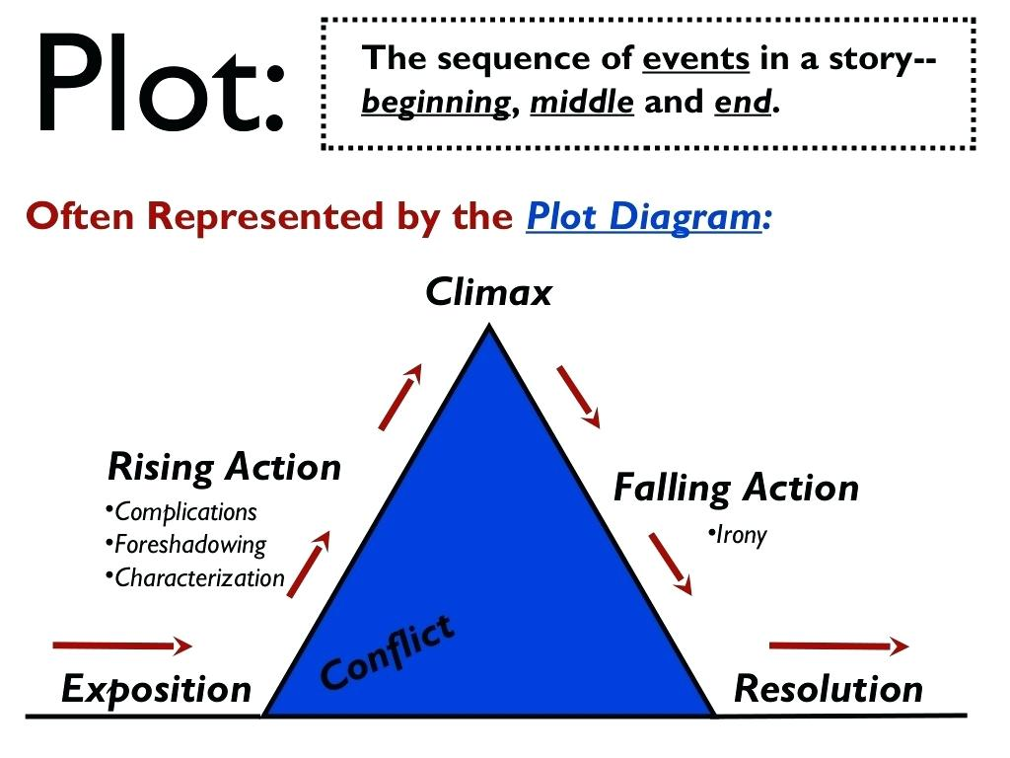

Slide 3
Introductory info, setting, characters, opening info

Slide 4
Often the inciting incident-starts rising action
Introductory info, setting, characters, opening info

Slide 5
Building energy, asking questions
Often the inciting incident-starts rising action
Introductory info, setting, characters, opening info

Slide 6
Highest point of energy, turning point, protagonist and antagonist come face to face!
Building energy, asking questions
Often the inciting incident-starts rising action
Introductory info, setting, characters, opening info

Slide 7
Highest point of energy, turning point, protagonist and antagonist come face to face!
Building energy, asking questions
Lowering energy, answering questions you still have
Often the inciting incident-starts rising action
Introductory info, setting, characters, opening info

Slide 8
Highest point of energy, turning point, protagonist and antagonist come face to face!
Building energy, asking questions
Lowering energy, answering questions you still have
Often the inciting incident-starts rising action
Everything important is solved, even if we don’t like it.
Introductory info, setting, characters, opening info

Slide 9
Highest point of energy, turning point, protagonist and antagonist come face to face!
Building energy, asking questions
Lowering energy, answering questions you still have
Often the inciting incident-starts rising action
Everything important is solved, even if we don’t like it.
Introductory info, setting, characters, opening info

Slide 10
Highest point of energy, turning point, protagonist and antagonist come face to face!
Building energy, asking questions
Lowering energy, answering questions you still have
Often the inciting incident-starts rising action
Everything important is solved, even if we don’t like it.
Introductory info, setting, characters, opening info

Slide 11
____________________________________________________________________________________________________
________________________________________________________________________________
____________________________________________________________________________
____________________________________________________________
______________________________________________________________________________
___________________________________________________________________________

